Slide 1

Convolutional Neural Network: Image segmentation with Patches and without
By Alexander Baumann
Math 6346
Dr. Cao

Slide 2
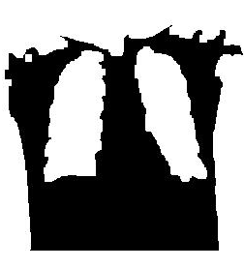
Image Segmentation
Create objects in images
Easier to Analyze
Locate Pathologies

Slide 3
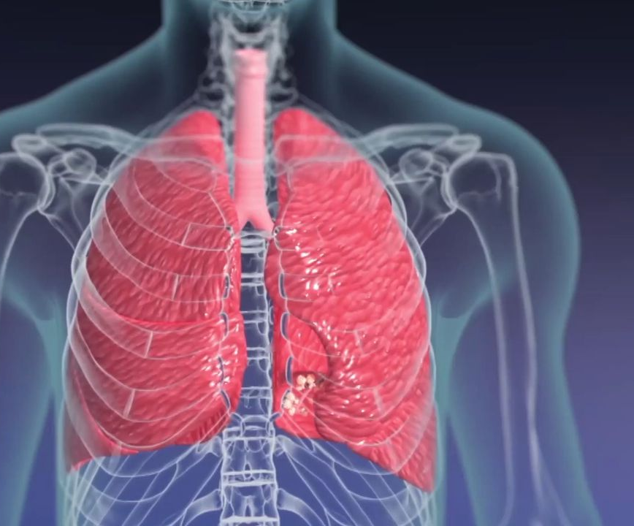
3D Model of Lungs
Notice the cardiac notch

Slide 4
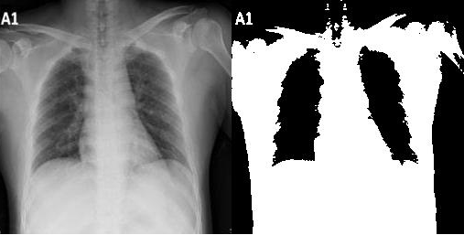
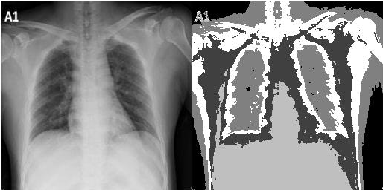
Quick Comparison
Imbinarize()
Imsegkmeans( , 5)

Slide 5

What if we wanted to segment more naturally?
Neural Network
-Won’t rely on specific intensity value
-Potentially much more information to draw on
-Recognize hidden patterns

Slide 6
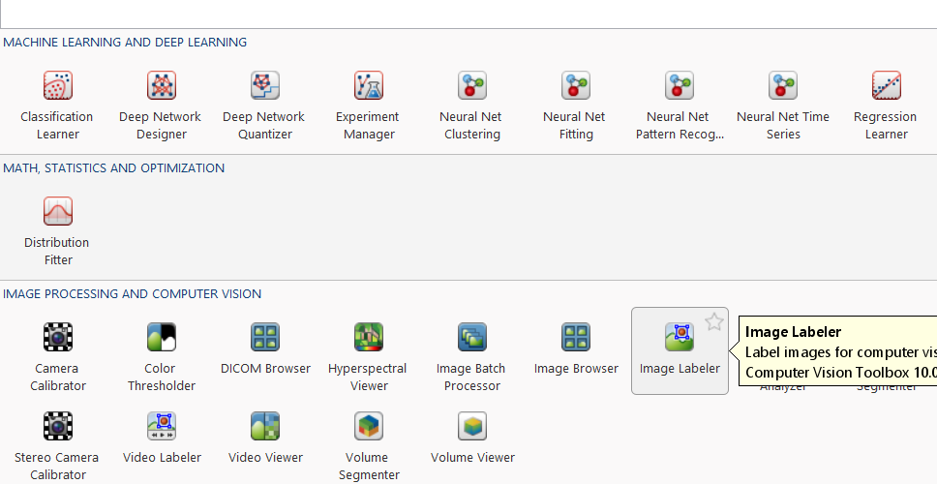
MATLAB Neural Network
MATLAB has a robust yet easy to use system
Apps allow for easy image preprocessing, labeling, and network design

Slide 7
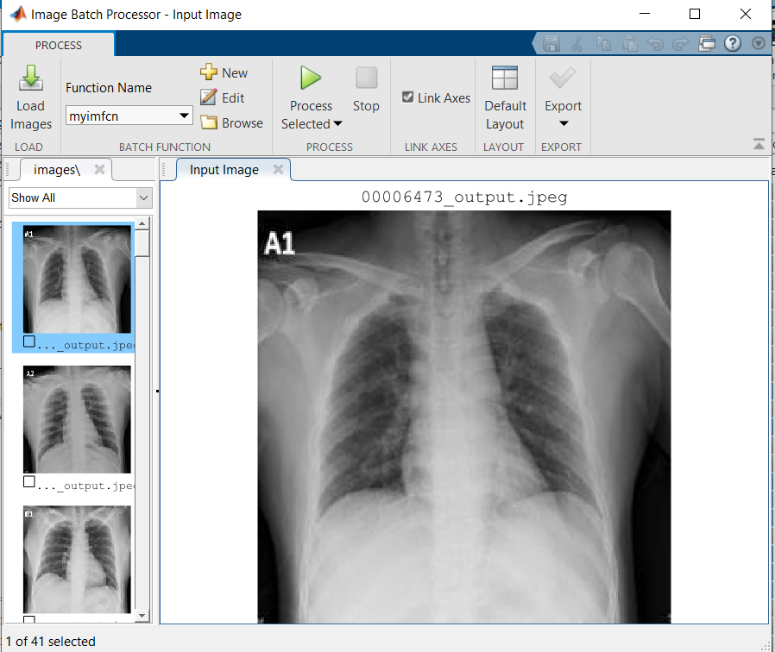
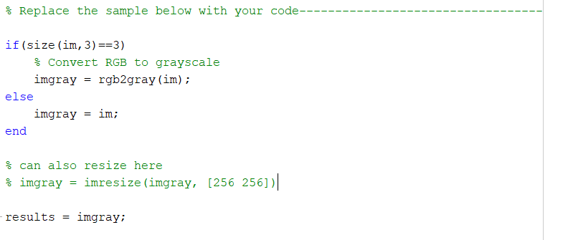
Preprocessing
Extraordinarily important
All images must be same size
Easier if all images were same: color or gray

Slide 8
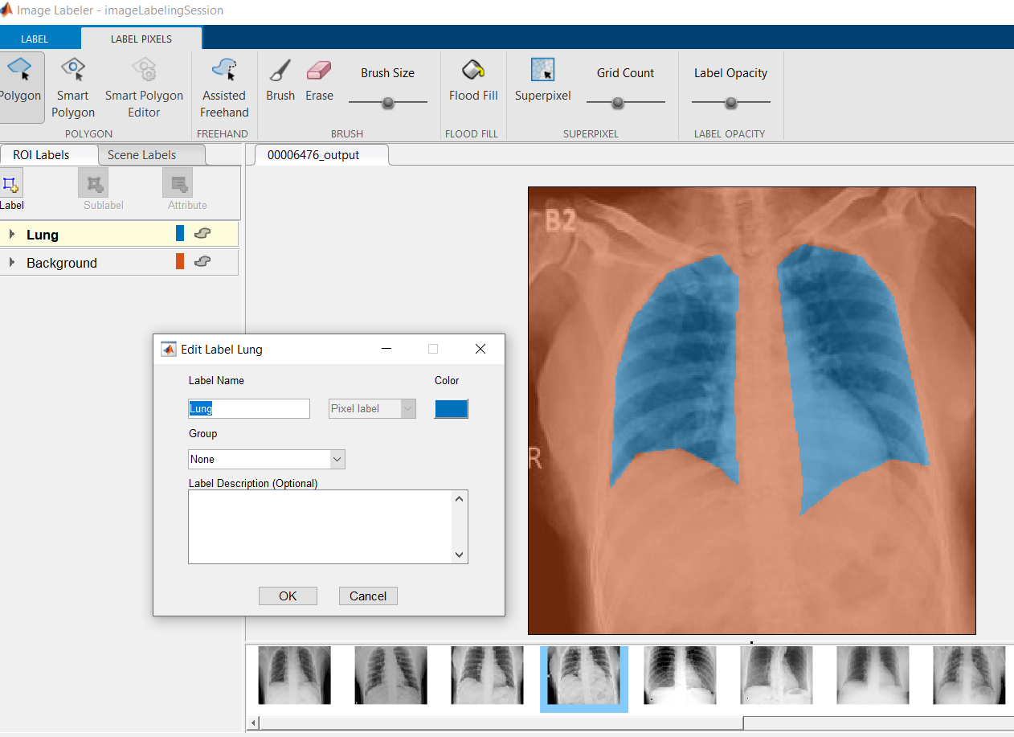
Labeling
Select Pixel Label
Export to file
Don’t change image names afterwards
Can create algorithm to label pixels
Several ways of labeling pixels: polygon, brush, fill
Polygon worked best for the lungs

Slide 9
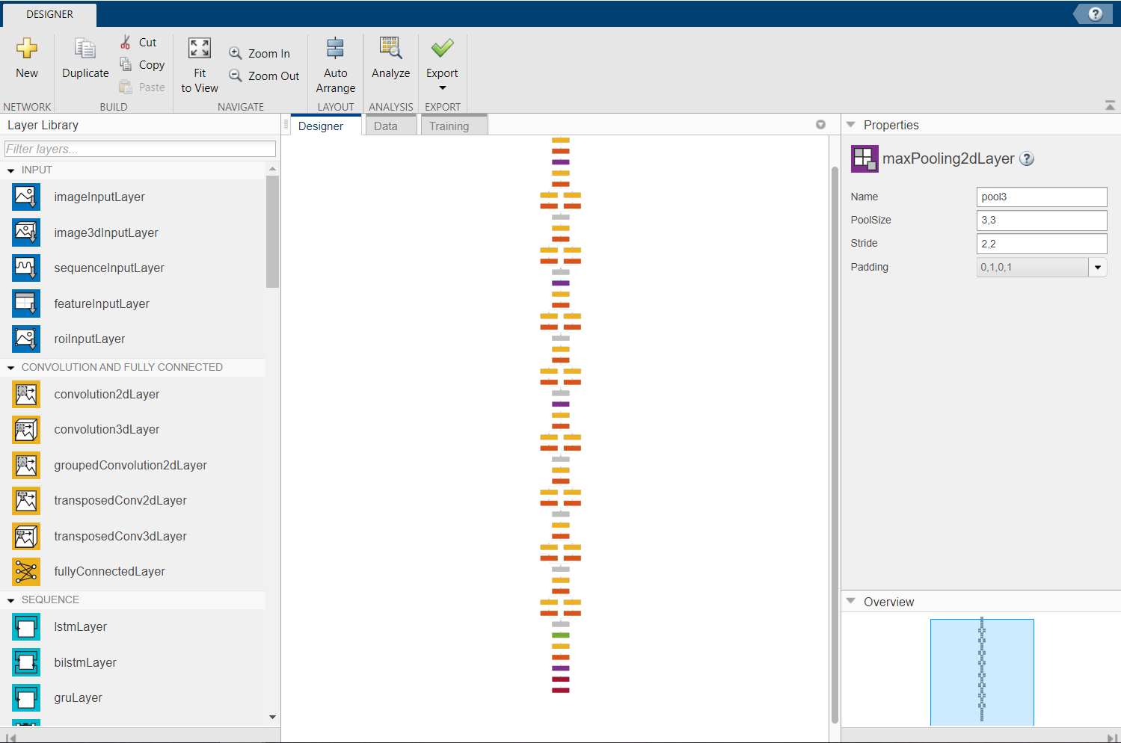
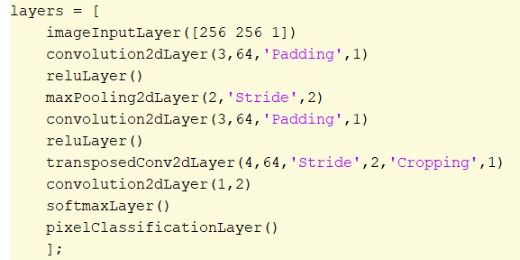
Network Design
Matlab has thorough documentation for how the layers fit
Designer or code

Slide 10
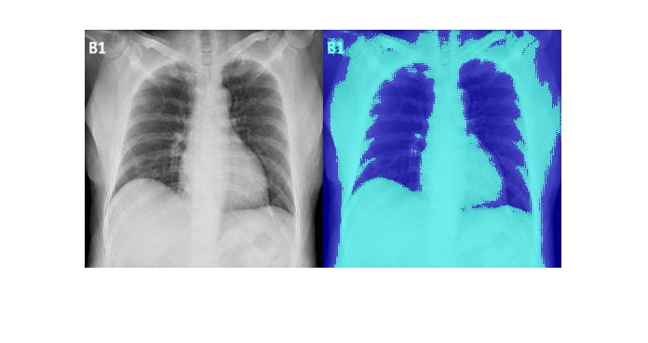
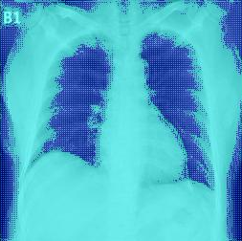
Patches or No Patches
Original Image and Patches Applied
No Patches

Slide 11
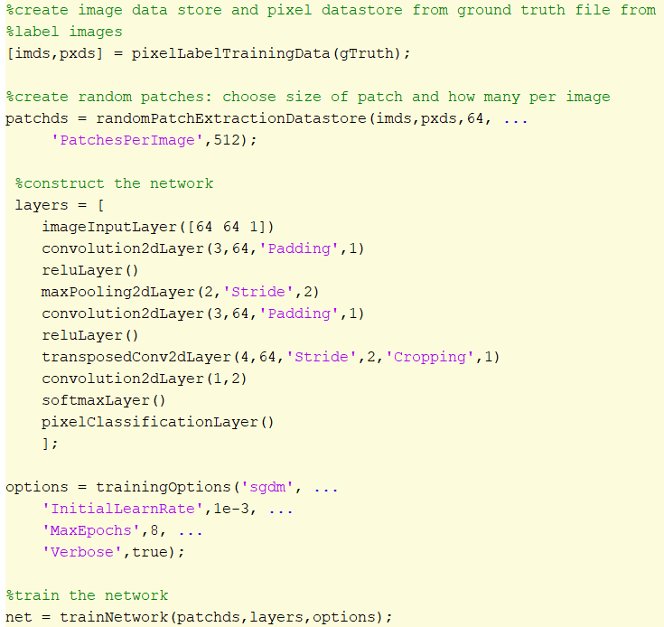
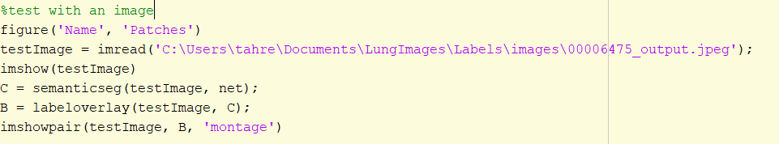
Algorithm
Use gTruth object
Create image and pixel datastores
Create random patches
Construct and train network
Test network

Slide 12
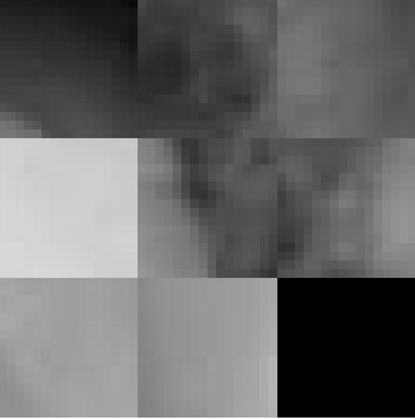

Results Comparison 16, 32, 64-pixel patch
Sample patches
Image and Segmentation

Slide 13
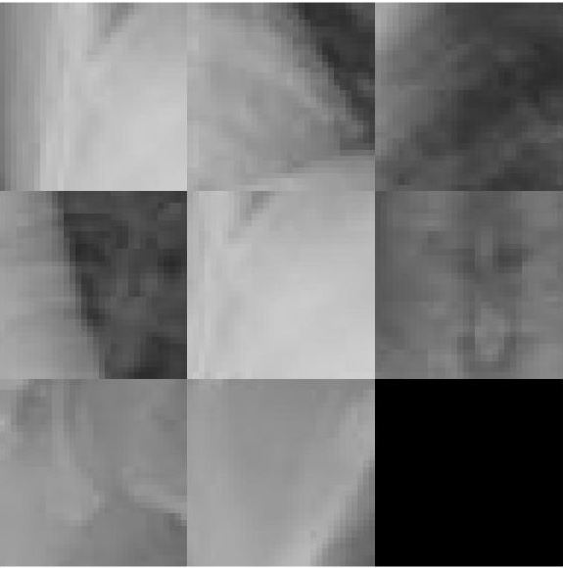
Results Comparison 16, 32, 64-pixel patch
Sample patches
Image and Segmentation

Slide 14
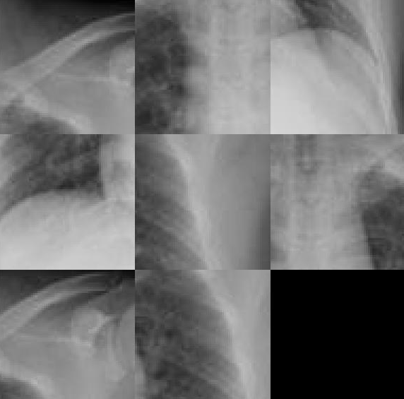
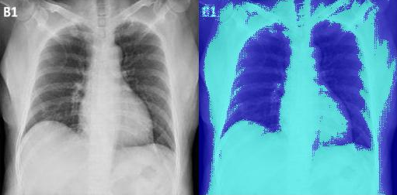
Results Comparison 16, 32, 64-pixel patch
Sample patches
Image and Segmentation

Slide 15
Other Differences in the Neural Networks
Patch Size | Time (Single CPU) | Average Mini-batch accuracy (8 epochs)
16-pixels | 1m 10s | 70.6%
32-pixels | 3m 55s | 78.68%
64-pixels | 14m 43s | 82.71%

Slide 16

Future Directions
Increase accuracy of neural networks
More training images
More layers in the network
Crop the images to exclude black background
Label other anatomical features in the x-ray
Heart
Ribs
Spine
Scapula
Scarring
Algorithm for pixel labeling

